Slide 1
Advance web scraping and AI-assisted analysis
A 3-days training program
June …-…, 2024
Dr. Anil Shrestha
Undersecretary (Account)
Financial Administration Section
National Statistics Office

Slide 2
Outline
Day 1
Session 1: Introduction to web scraping
Session 2: Excel and Google Sheets for web scraping
Session 3: Setting up R and Python for web scraping
Day 2
Session 4: Web scraping with R
Session 5: Web scraping with Python
Session 6: Data harvesting via API’s (e.g., IMF, World Bank, data.gov.in)

Slide 3
Outline …
Day 3
Session 7: AI-assisted document analysis
Session 8: AI-powered writing

Slide 4
Introduction to web scraping

Slide 5
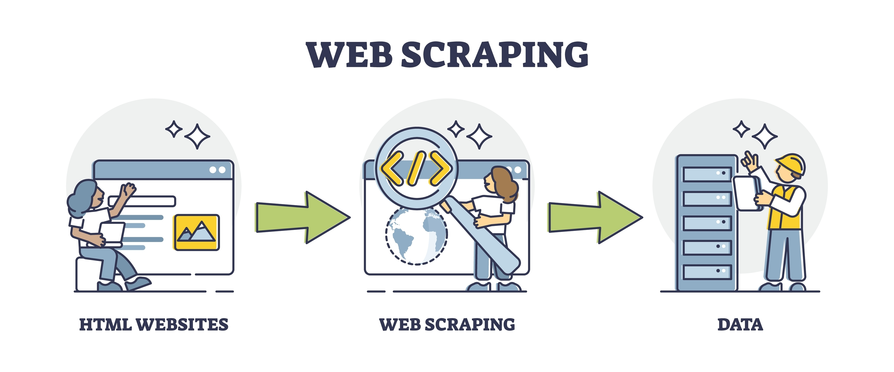
What is web scraping?
An automated extraction of data from websites.

Slide 6
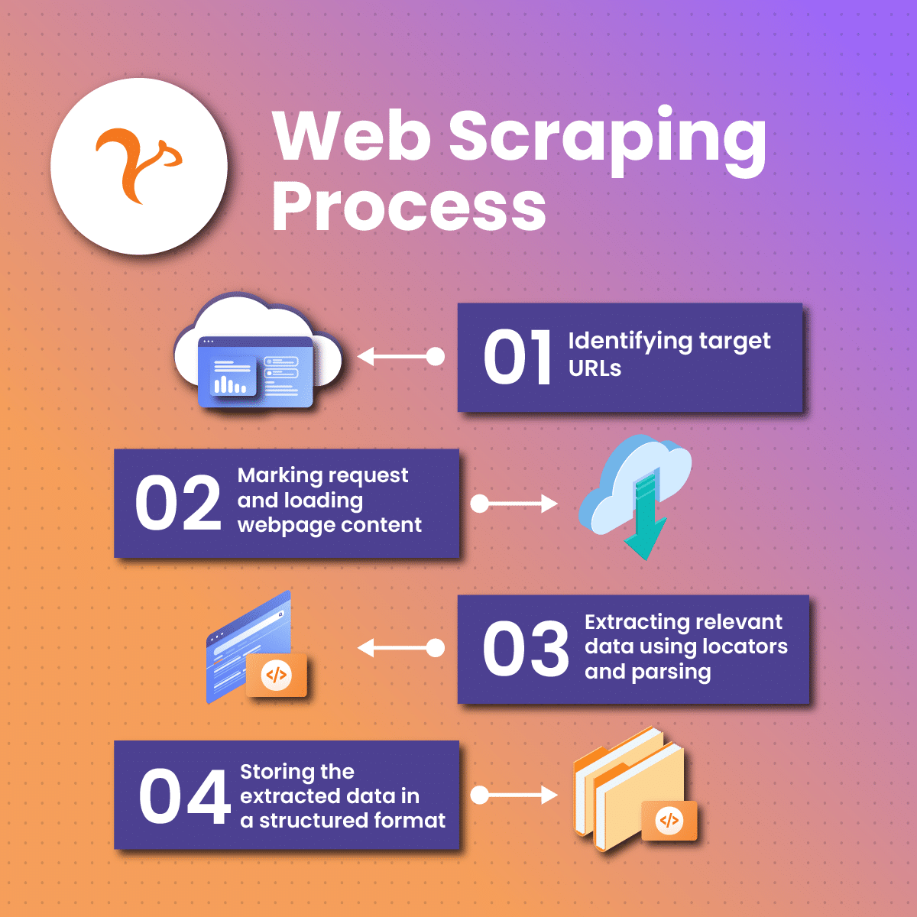
Process of web scraping
Fetching web page and its html source.
Parsing the content (understanding the structure of the web page).
Extracting the desired data (product, prices, reviews etc.)
Cleaning, manipulating, and storing the data.

Slide 7
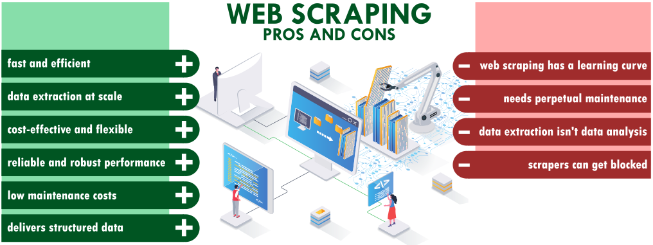
Why use web scraping?

Slide 8
Web scraping: Demo

Slide 9
Demo
Web scraping data of today’s share prices of NEPSE from https://www.sharesansar.com/today-share-price using excel, google sheet, R, and Python.
#python code
import pandas as pd
df = pd.read_html("https://www.sharesansar.com/today-share-price")[0]
print(df)
df.to_csv('share.csv')
#R code
library(rvest)
df <- html_table(read_html("https://www.sharesansar.com/today-share-price"))[[1]]
View(df)
write.csv(df, file = 'share.csv')

Slide 10
Thank you

